Slide 1
Campaign Finance, Lobbying, and the Code of Ethics for Legislative Employees
Brian M. Bell, MPA
Administrator
David Buerger
Staff Counsel

Slide 2
About The Ethics Commission
Created by 2015 Wisconsin Act 118
6 members – Partisan Appointments
2 former judges, 4 others
4 year terms
Headed by Commission Administrator
One Staff Counsel; Six Other Staff Positons
All actions require four votes
Confidentiality: Advice & Investigations

Slide 3
Responsibilities
Administer Wisconsin Statutes
Chapter 11: Campaign Finance
Subchapter III, Chapter 13: Lobbying
Subchapter III, Chapter 19: Code of Ethics
Notes:
Elections Commission – Chapters 5-10, 12

Slide 4
Jurisdiction
Co-Equal Jurisdiction with District Attorneys, but historically…
Ethics Commission | District Attorneys
Legislators, aides, service agencies Governor, Lt. Governor, appointees, secretaries, deputies, executive assistants, administrators Justices and judges Lobbyists and Lobbying Principals (organizations) Most campaign committees Any individual holding a state public office | Code of Ethics for Local Officials Local candidate and local referendum committees

Slide 5
Important Laws to Know

Slide 6
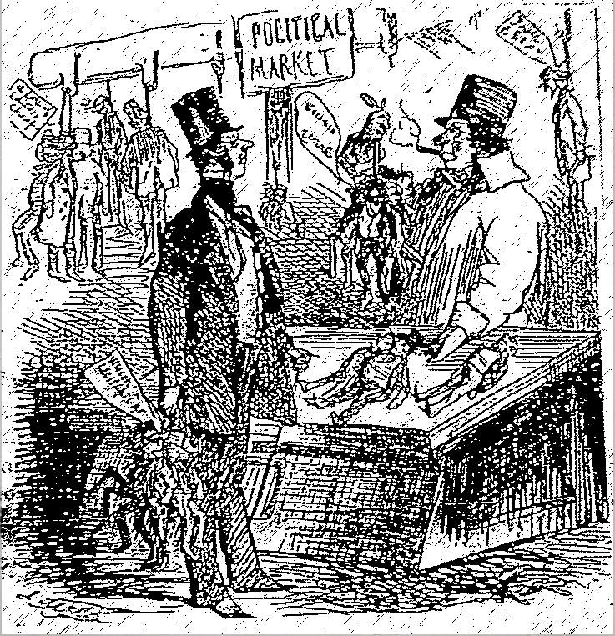
POLITICAL MARKET
Conscientious Rail-road President to Dealer: “Ah! Let me see. I think I’ll take this bunch of Legislators at $5000 a head. The Senators, at - what price did you say?”
Dealer: “Can’t afford ‘em less than $10,000 each.”
R.R.P.: “Well, hand them over. I suppose I’ll have to take the lot.”
Dealer: “Anything else to-day? I have a lot of Editors, at various prices, from a Thousand down to Fifty Cents.”
R.R.P.: “No, nothing in that way, to-day. But I want a Governor very much indeed, and will stand $50,000 for him. Get me a Wisconsin one, if possible!”
Cartoon published in Harper’s Weekly of June 12, 1858, at the time of the Land Grant Investigation
Notes:
Governor Bashford (5th) bribery scandal: Bashford declined re-nomination from the Republican Party, and left office at the end of his term on January 4, 1858. Mere weeks later, an investigation was launched regarding bribes that he and members of his administration had accepted from the La Crosse & Milwaukee Railroad Company in exchange for approval of a major land grant. Bashford himself had received the largest payoff in the form of $50,000 in stocks and $15,000 in cash from the railroad company (approximately 1.5M to Bashford in today’s money!); state legislators and a Wisconsin Supreme Court justice were also involved in payoffs exceeding $400,000 in total. (Approximately 9.7M in today’s money.) We have regulated lobbying ever since (2nd state to do so).
Ethics of public officials began to be regulated in 1897 with the ban on bribery, a ban on corporate electioneering in 1905, and the Corrupt Practices Act in 1911 (which was recodified in the 70’s into the ethics and campaign finance laws).

Slide 7
Important Laws to Know
Lobbying
13.625 – prohibited practices and exceptions
Campaign Finance
“50 Piece” Rule and exceptions
Code of Ethics
Use of office for financial gain
Influence and reward
Food, drink, transportation, lodging
Use of confidential information for private gain
Unlawful benefit
Conflicts of Interest

Slide 8
Lobbying: Prohibited Practices
Wis. Stat. §13.625
No lobbyist or lobbying principal may give to an agency official, legislative employee, any elective state official, or candidate for state elective office, or to the candidate committee of the official, employee or candidate:
Lodging
Transportation
Food, meals, beverages
Money or any other thing of pecuniary value
Except…

Slide 9
Campaign Contributions
A lobbyist may deliver a contribution at any time
A lobbyist may make a personal contribution if the “window” is open
Between the first day to circulate nomination papers and the date of the election
And a contribution to a candidate for legislative office can only be given by a lobbyist if the Legislature has concluded its final floor period and is not in extraordinary session
A lobbyist may contribute to their own campaign at any time

Slide 10
Other Exceptions
Providing or receiving any thing of pecuniary value involving a relative or an individual who resides in the same household
Lobbyists may provide educational/informational materials
Providing or receiving payment or reimbursement for actual and reasonable expenses allowed under Wis. Stat. §19.56: Honorariums, Fees and Expenses
Other very limited exceptions to the blanket prohibition on accepting anything of pecuniary value from a lobbyist or principal
Notes:
Relative = within 3 degrees of kinship (includes fiancées)
See Guideline 1211

Slide 11
50 Piece Rule
Wis. Stat. §11.1205: Use of government materials by candidates
No person elected to state or local office
Who becomes a candidate for national, state, or local office
May use public funds for the cost of materials or distribution for 50 or more pieces of substantially identical materials distributed after the first day to begin circulating nomination papers
Except…
Notes:
Saw you in the news versus school visit photos
Substantially identical
Others sending on your behalf

Slide 12
50 Piece Rule - Exceptions
Answers to communications of constituents
Actions taken by a state or local administrative officer pursuant to a specific law, ordinance, or resolution which authorizes or directs action to be taken
Communications between members of the Legislature regarding the legislative or deliberative process while the Legislature is in session
Communications not exceeding 500 pieces by member of the Legislature relating solely to the subject matter of a special or extraordinary session, made during the period between the date the session is called and 14 days after the adjournment of the session

Slide 13
Scheduling and Communications
Making campaign appointments prohibited.
Recording hour and location of campaign appointments; incidental communications with campaign committee okay.
Providing calendar information permitted.
Refer campaign messages to candidate or campaign committee.
Notes:
See Guideline 1247

Slide 14
Use of Office for Financial Gain
Wis. Stat. §19.45(2)
No state public official may use his or her public position or office to obtain financial gain or anything of substantial value for the private benefit of himself or herself or his or her immediate family, or for an organization with which he or she is associated.
Exceptions:
Campaign contributions
Donations to non-profits
Notes:
Donations to non-profits only an exception for candidates/officeholders

Slide 15
Influence and Reward
Wis. Stat. §19.45(3)
No person may offer or give to a state public official, directly or indirectly, and no state public official may accept from any person, directly or indirectly, anything of value if it could reasonably be expected to influence the state public official’s vote, official actions, or judgment, or could reasonably be considered as a reward for any official action or inaction on the part of the state public official.
Notes:
Does not prohibit outside employment.

Slide 16
Food, Drink, Transportation, and Lodging
Wis. Stat. §19.45(3m)
No state public official may accept or retain any transportation, lodging, meals, food or beverage, or reimbursement therefor, except in accordance with § 19.56(3).
Exceptions:
Official talk or meeting
Unrelated to holding public office
State benefit
Reported as an expense by a political committee
WEDC/Department of Tourism
Notes:
Less restrictive than lobbyist prohibitions
Giving a talk versus attending a holiday party

Slide 17
Use of Confidential Information for Private Gain
Wis. Stat. §19.45(4)
No state public official may intentionally use or disclose information gained in the course of or by reason of his or her official position or activities in any way that could result in the receipt of anything of value for himself or herself, for his or her immediate family, or for any other person, if the information has not been communicated to the public or is not public information.

Slide 18
Unlawful Benefits
Wis. Stat. §19.45(5)
No state public official may use or attempt to use the public position held by the public official to influence or gain unlawful benefits, advantages or privileges personally or for others.

Slide 19
Conflicts of Interest
Wis. Stat. §19.46(1): No state public official may:
Take any official action substantially affecting a matter in which the official, a member of his or her immediate family, or an organization with which the official is associated has a substantial financial interest.
Use his or her office or position in a way that produces or assists in the production of a substantial benefit, direct or indirect, for the official, one or more members of the official’s immediate family either separately or together, or an organization with which the official is associated.
Notes:
Associated means you or family are “director, officer, or trustee, or owns/controls at least 10%”

Slide 20
Statement of Economic Interests
Annual requirement
Must identify investments, real estate, businesses, and creditors as of the last day of the prior year.
All direct sources of family income from prior year of $1,000 or more.
All sources of income from prior year of $10,000 or more received from partnerships, sub S corporations, service corporations, and LLCs (including customers, clients, and tenants) in which your family has a 10% or greater interest.
Notes:
Due April 30th each year if not up for election. Due the 3rd day following the ballot access deadline if you will be on the ballot. Due no later than 21 days after appointment to office.
Investments, business activities, commercial customers, partners, real estate, officer/director, agent, creditors AS OF December 31
Employers, additional sources of income, gifts, honoraria at any point IN THE CALENDAR YEAR.
Legislative Officials required to file:
All Legislators
LAB Auditors
Chief Clerks and Sergeants-At-Arms
State Public Officials whose appointment require the advice and consent of the Senate

Slide 21
Hypotheticals: How would you handle this?

Slide 22
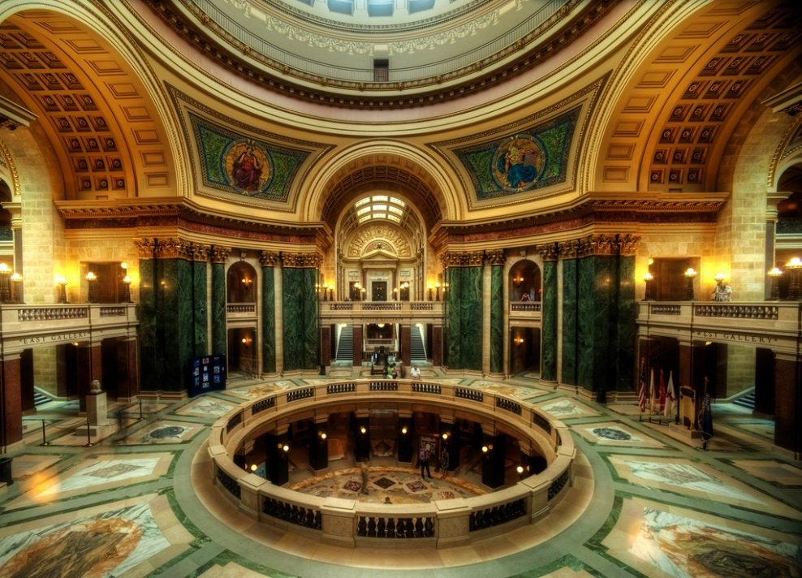
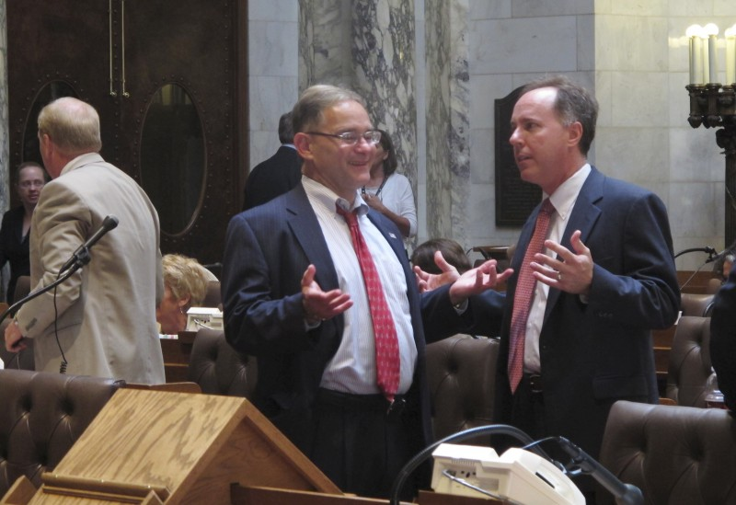
Campaigning
Can a candidate take campaign pictures at the State Capitol?

Slide 23
Campaigning
Don’t use any state resource for campaigning (email, computers, photocopier, etc.)
Staff may not engage in campaign activity on public time or in public offices.
May not solicit or receive contributions while engaged in official duties
Do not use access to any non-public areas.

Slide 24
Use of Office for Financial Gain
A nonprofit organization asked a Legislator if they could include as a raffle prize a “lunch with a legislator”, as part of their efforts to fundraise.
Can the Legislator participate?

Slide 25
Use of Office for Financial Gain
Candidates can solicit donations for a nonprofit organization with which they are associated
The candidate or an immediate family member:
Is a director, officer, or trustee
Owns or controls, directly, or indirectly, and severally or in the aggregate, at least 10 percent of the outstanding equity
Or a member of the candidate’s immediate family is an authorized representative or agent

Slide 26
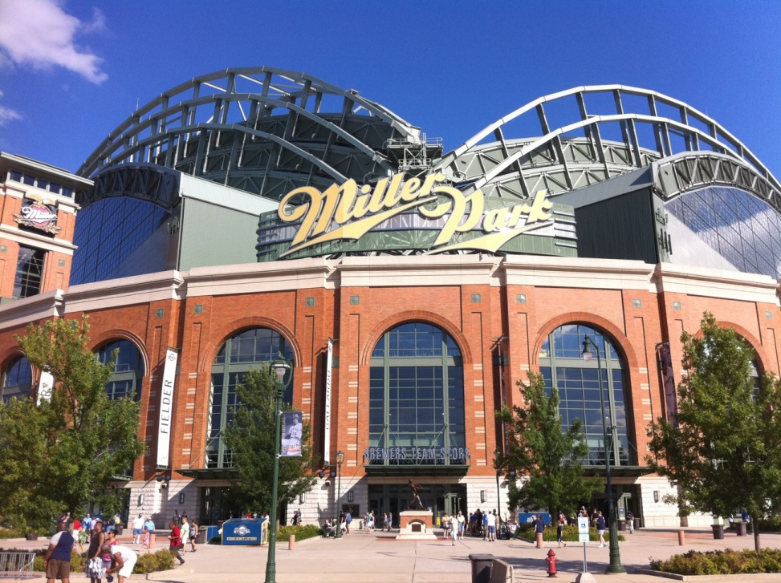
Tickets/Luxury Boxes
Old friend from college invites you
Premium seats/skybox
May you accept the ticket?

Slide 27
Accepting Gifts
Don’t accept anything from a lobbyist or lobbying principal – even if you pay for it.
Don’t accept items or services of more than trivial value that are offered to you because of your official position.
You may accept something if it’s not from a lobbyist and not related to your public office.
You may accept something if it is available to the general public
Must report on Statement of Economic Interests if over $50 (face value may not be true value)
If spouse is the invitee and you are the guest, that is okay.
Notes:
Limited exceptions to blanket prohibition on lobbyist/principal gifts under 13.625
See also 19.451 for special restrictions on stadiums exempt from property taxes (Miller/Lambeau). No person serving in a national, state, or local office may accept any discount on the price of admission or parking.

Slide 28
Disposition of Gifts
Treat the item as being given to the Legislature.
Turn the item over to another state agency or to a public institution, such as a local school, library, or museum, that can use the item.
Donate the item to a charitable organization (other than one of which the official or a family member is an officer, director, or agent).
Return the item to the donor.
If the donor is neither a lobbyist nor an organization that employs a lobbyist, purchase the item (by paying the donor the full retail value) and retain it.
Notes:
Guideline 1235

Slide 29
Teaching A Seminar
Invited by your alma mater to teach a seminar
Can you teach the seminar?
Can you be paid?

Slide 30
Compensation for Services
Permitted to teach as a public official.
Actually encouraged to go to meetings and gatherings to discuss processes, proposals, or issues affecting your office.
May receive and retain reasonable compensation
Must prepare/present without more than incidental reliance on state resources
Still cannot accept from a lobbyist or lobbying principal
Compensation includes gifts, tickets, entertainment, reimbursement of travel, lodging, meals for spouse.
Must report compensation on Statement of Economic Interests

